Slide 1
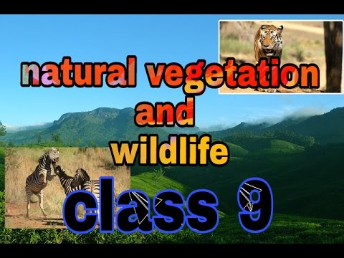
MODULE - 1

Slide 2








INTRODUCTION
NATURAL VEGETATION- It means the vegetation grown naturally without human aid. It is also known as virgin vegetation.
WILDLIFE- It is the animals, birds, insects found in nature.
India is a vast country and has a vast biodiversity.
India is one of the twelve mega bio-diversity countries of the world.
India, has 47,000 plant species and 89,000 animal species.
FAUNA-It is referred to the animal species of a particular area .
FLORA-It is referred to the plant species of a particular area.

Slide 3



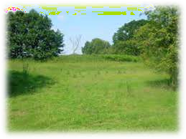





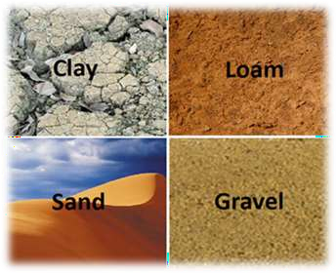
FACTORS AFFECTING FLORA AND FAUNA KINGDOM
Relief
– Land
It affects the natural vegetation in many ways.
That is why we find different types of natural vegetation in various parts of our country.
Fertile land is devoted to agriculture while the forests give shelter to wildlife.
– Soil
It also affects the vegetation.For this reason only dessert plants or animals differ from the mountainous plants or animals.

Slide 4






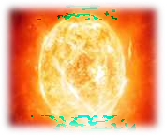

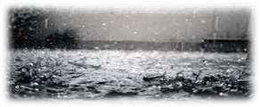

Climate
  Temperature
As the temperature decrease the type of vegetation changes from Tropical to Subtropical to Temperate to Alpine.
  Photoperiod(Sunlight)
The difference in sunlight occurs due to latitude. Sunlight also affects the growth of plants as plants requires sunlight for photosynthesis.
  Precipitation
It also effects the vegetation because water is the foremost requirement for photosynthesis.

Slide 5


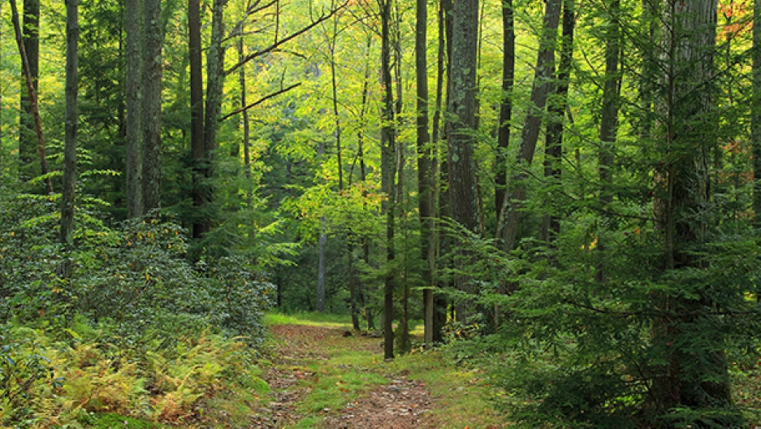
IMPORTANCE OF FOREST
Forests are very helpful in
  modifying local climate
  Controling soil erosion
  Regulating stream flow
  Supporting industries
  Provide shelter to communities
  Offer panoramic scene
  Controls wind, temperature
  Causes rainfall
  Shelter to wildlife

Slide 6



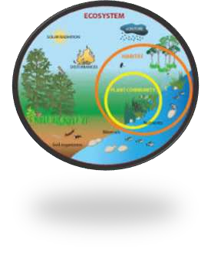




Ecosystem
It is the inter dependence and inter relation of the animals on plants or vice versa.
Humans are also a part of ecosystem.
THEY PLAY A CRUCIAL ROLE IN ECOSYSTEM BY UTILIZING THE VEGETATION AND WILDLIFE
– The greed of humans lead to ecological imbalance.
A very large ecosystem on land having distinct types of vegetation and wildlife
is called BIOME

Slide 7

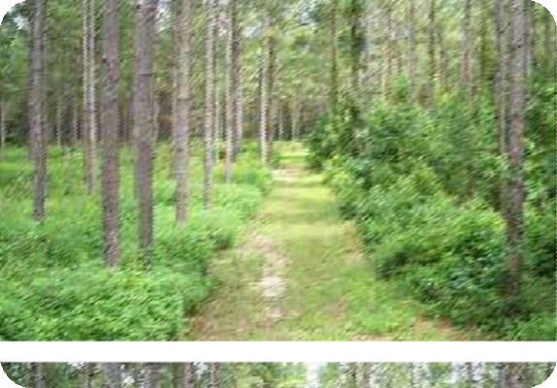
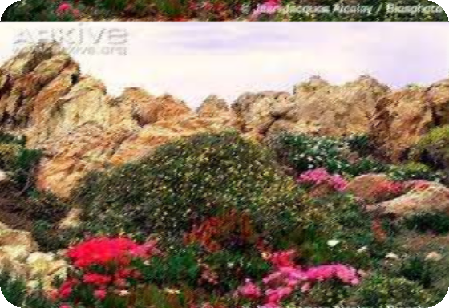



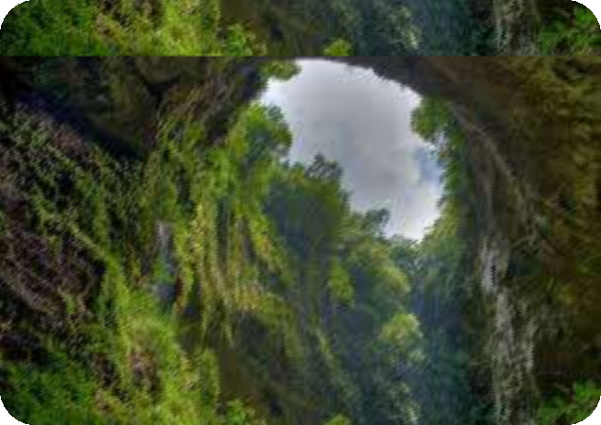
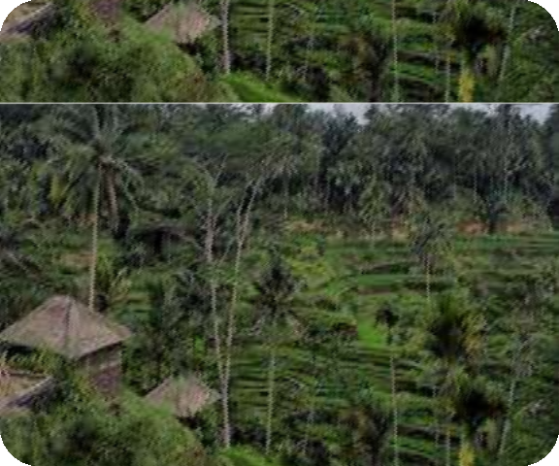


VEGETATION

Slide 8

TYPES OF VEGETATION
.Tropical Evergreen Forests
Tropical deciduous forest
Tropical thorn forest and scrubs
  Montane forest
Mangrove forest

Slide 9



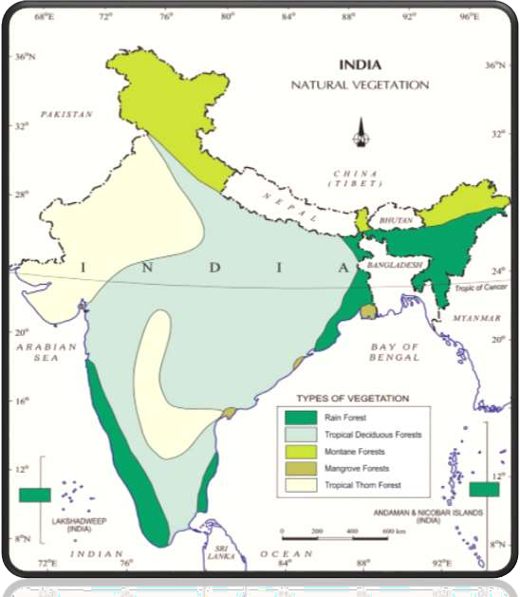
NATURAL VEGETATION IN
INDIA

Slide 10



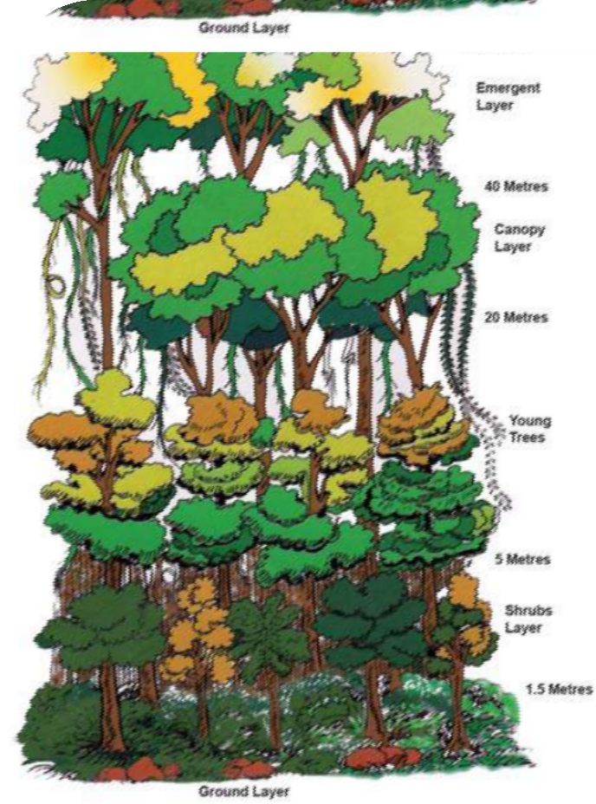
TROPICAL RAIN FOREST
These areas are restricted to heavy rainfall.
Areas covered
  Western Ghats, Lakshadweep, Andaman, and Nicobar, Assam and Tamil Naidu coast.
Rainfall is more than 200 cm.
Trees’ height can be upto 60 m.
Luxuriant vegetation of all kinds.
No definite time for trees to shed their leaves.
Vegetation found
  Ebony, rosewood, rubber, cinchona,
mahogany.
Animals found
  Elephants, monkey, lemur and deer, one
horned rhinoceros, birds, bats, sloth, scorpions and snails.

Slide 11


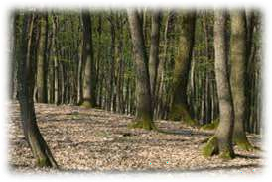






TROPICAL DECIDUOUS
They are also known asFmOonsRooEn SforTest.
Receive rainfall between 200 cm to 70 cm.
Shed their leaves for 6-8 weeks in dry summer.
Further divided into
  Moist and dry deciduous forest.
Moist deciduous forest
  Receive rainfall between 200 cm to 100 cm.
  Areas covered
    Himalayas, Jharkhand, West Orissa, Chhattisgarh, Western Ghats.
  Vegetation found
    Teak, Bamboos, sal, shisham, sandalwood, khair, kusum, arjun, mulberry.
Dry deciduous forest
  Receive rainfall between 70cm to 100cm.
  Areas covered
    peninsular plateau, plains of Bihar and Uttar Pradesh.
  Vegetation found
  Teak, Sal, Peepal, Neem.
Animals found in this type of forest are
  lion, tiger, pig, deer and elephant. A huge variety of birds, lizards, snakes, and tortoises.

